Slide 1

Sockets Programming
Socket to me!

Slide 2
Network Application Programming Interface (API)
The services provider (often by the operating system) that provide the interface between application and protocol software.
Application
Network API
Protocol A
Protocol B
Protocol C

Slide 3
Network API wish list
Generic Programming Interface.
Support for message oriented and connection oriented communication.
Work with existing I/O services (when this makes sense).
Operating System independence.

Slide 4
TCP/IP
TCP/IP does not include an API definition.
There are a variety of APIs for use with TCP/IP:
Sockets
TLI, XTI
Winsock
MacTCP
Application
Network API
TCP/IP
ATM
ISDN

Slide 5
Functions needed:
Specify local and remote communication endpoints
Initiate a connection
Wait for incoming connection
Send and receive data
Terminate a connection gracefully
Error handling

Slide 6
Berkeley Sockets
Generic:
support for multiple protocol families.
address representation independence
Uses existing I/O programming interface as much as possible.

Slide 7
Socket
A socket is an abstract representation of a communication endpoint.
Sockets work with Unix I/O services just like files, pipes & FIFOs.
Sockets (obviously) have special needs:
establishing a connection
specifying communication endpoint addresses

Slide 8
Creating a Socket
int socket(int family,int type,int proto);
family specifies the protocol family (PF_INET for IPv4).
type specifies the type of service (SOCK_STREAM, SOCK_DGRAM).
protocol specifies the specific protocol (usually 0, which means the default,
IPPROTO_TCP, IPPROTO_UDP).

Slide 9
socket()
The socket() system call returns a socket descriptor (small integer) or -1 on error.
socket() allocates resources needed for a communication endpoint - but it does not deal with endpoint addressing.

Slide 10
struct sockaddr_in (IPv4)
struct sockaddr_in {
uint8_t sin_len;
sa_family_t sin_family;
in_port_t sin_port;
struct in_addr sin_addr;
char sin_zero[8];
};
A special kind of sockaddr structure

Slide 11
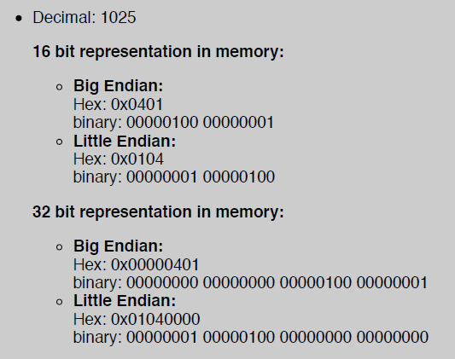
Network Byte Order (Big)
Big endian (IBM 370, SUN Sparc, Network)
Little endian (Pentium, VAX, x86, x64)

Slide 12
Network Byte Order (Big)
All values stored in a sockaddr_in must be in network byte order.
sin_port a TCP/IP port number.
sin_addr an IP address.

Slide 13
Network Byte Order Functions
‘h’ : host byte order ‘n’ : network byte order
‘s’ : short (16bit) ‘l’ : long (32bit)
uint16_t htons(uint16_t);
uint16_t ntohs(uint16_t);
uint32_t htonl(uint32_t);
uint32_t ntohl(uint32_t);

Slide 14
Assigning an address to a socket
The bind() system call is used to assign an address to an existing socket.
int bind( int sockfd,
const struct sockaddr *myaddr, int addrlen);
bind returns 0 if successful or -1 on error.
const!

Slide 15
bind()
calling bind() assigns the address specified by the sockaddr structure to the socket descriptor.
You can give bind() a sockaddr_in structure:
bind( mysock,
(struct sockaddr*) &myaddr,
sizeof(myaddr) );

Slide 16
bind() Example
int mysock,err;
struct sockaddr_in myaddr;
mysock = socket(AF_INET,SOCK_STREAM,
IPPROTO_TCP);
myaddr.sin_family = AF_INET;
myaddr.sin_port = htons( portnum );
myaddr.sin_addr = htonl( ipaddress);
err=bind(mysock, (sockaddr *) &myaddr, sizeof(myaddr));

Slide 17
Port - who cares ?
Clients typically don’t care what port they are assigned.
When you call bind you can tell it to assign you any available port:
myaddr.port = htons(8600);

Slide 18
IPv4 Address Conversion
unsigned long inet_addr( "127.0.0.1" );
int inet_aton( char *, struct in_addr *);
Convert ASCII dotted-decimal IP address to network byte order 32 bit value. Returns 1 on success, 0 on failure.
char *inet_ntoa(struct in_addr);
Convert network byte ordered value to ASCII dotted-decimal (a string).

Slide 19
bind() Example
int mysock,err;
struct sockaddr_in myaddr;
mysock = socket(AF_INET,SOCK_STREAM,
IPPROTO_TCP);
myaddr.sin_family = AF_INET;
myaddr.sin_port = htons( 8600 );
myaddr.sin_addr = inet_addr( "127.0.0.1" );
err=bind(mysock, (sockaddr *) &myaddr, sizeof(myaddr));

Slide 20
Other socket system calls
General Use
read()
write()
close()
Connection-oriented (TCP)
connect()
listen(),accept()
send(), recv()
Connectionless (UDP)
sendto()
recvfrom()

Slide 21
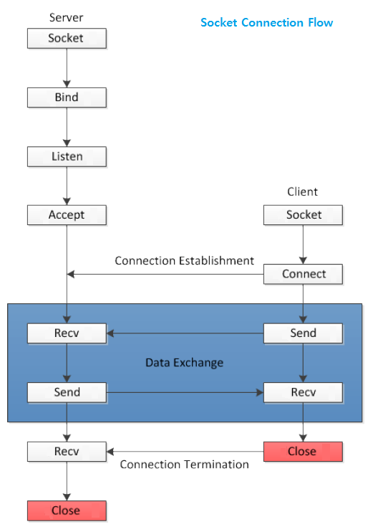
TCP Programming

Slide 22
TCP Sockets Programming
Creating a passive mode (server) socket.
Establishing an application-level connection.
send/receive data.
Terminating a connection.

Slide 23
Creating a TCP socket
int socket(int family,int type,int proto);
int sock;
sock = socket( AF_INET, SOCK_STREAM,
IPPROTO_TCP);
if (sock<0) { /* ERROR */ }

Slide 24
Binding to well known address
int mysock;
struct sockaddr_in myaddr;
mysock = socket(AF_INET,SOCK_STREAM, IPPROTO_TCP);
myaddr.sin_family = AF_INET;
myaddr.sin_port = htons(8600);
myaddr.sin_addr = htonl( INADDR_ANY );
bind(mysock, (sockaddr *) &myaddr, sizeof(myaddr));

Slide 25
Establishing a passive mode TCP socket
Passive mode:
Address already determined.
Tell the kernel to accept incoming connection requests directed at the socket address.
3-way handshake
Tell the kernel to queue incoming connections for us.

Slide 26
listen()
int listen( int sockfd, int backlog);
sockfd is the TCP socket (already bound to an address)
backlog is the number of incoming connections the kernel should be able to keep track of (queue for us).
listen() returns -1 on error (otherwise 0).

Slide 27
Accepting an incoming connection.
Once we call listen(), the O.S. will queue incoming connections
Handles the 3-way handshake
Queues up multiple connections.
When our application is ready to handle a new connection, we need to ask the O.S. for the next connection.

Slide 28
accept()
int accept( int sockfd,
struct sockaddr* cliaddr,
socklen_t *addrlen);
sockfd is the passive mode TCP socket.
cliaddr is a pointer to allocated space.
addrlen is a value-result argument
must be set to the size of cliaddr
on return, will be set to be the number of used bytes in cliaddr.

Slide 29
accept() return value
accept() returns a new socket descriptor (small positive integer) or -1 on error.
After accept returns a new socket descriptor, I/O can be done using the recv() and send() system calls.

Slide 30
Terminating a TCP connection
Either end of the connection can call the close() system call.
If the other end has closed the connection, and there is no buffered data, reading from a TCP socket returns 0 to indicate EOF.
shutdown( socket, SD_BOTH );
closesocket( socket);

Slide 31
Client Code
TCP clients can call connect() which:
takes care of establishing an endpoint address for the client socket.
don’t need to call bind first, the O.S. will take care of assigning the local endpoint address (TCP port number, IP address).
Attempts to establish a connection to the specified server.
3-way handshake

Slide 32
connect()
int connect( int sockfd,
const struct sockaddr *server,
socklen_t addrlen);
sockfd is an already created TCP socket.
server contains the address of the server (IP Address and TCP port number)
connect() returns 0 if OK, -1 on error

Slide 33
Reading from a TCP socket
recv(int socket, char *buffer, int len, int flag );
By default recv() will block until data is available.
reading from a TCP socket may return less than max bytes (whatever is available).

Slide 34
Writing to a TCP socket
int send( int socket, char *buf, int len, int flag);
send may not be able to write all num bytes (on a nonblocking socket).

Slide 35
Exercise
Make new project for each cpp file
Modify tcpclient.cpp to send messages
Refer tcpsrever.cpp
bind( socket, ( struct sockaddr* )&serverAddr, sizeof( serverAddr ))
Modify udpserver.cpp to receive messages
Refer udpclient.cpp
Compile and run in console mode
Property -> linker -> system -> /SUBSYSTEM:CONSOLE
Add socket library, ws2_32.lib
Property -> linker ->input -> additional dependency
SDL check -> No
Search using Google or MSDN for each function

Slide 36
UDP Programming

Slide 37
UDP Sockets Programming
Creating UDP sockets.
Client
Server
Sending data.
Receiving data.

Slide 38
Creating a UDP socket
int socket(int family,int type,int proto);
int sock;
sock = socket( AF_INET, SOCK_DGRAM,
IPPROTO_UDP);
if (sock<0) { /* ERROR */ }

Slide 39
Binding to well known address (typically done by server only)
int mysock;
struct sockaddr_in myaddr;
mysock = socket(AF_INET,SOCK_DGRAM, IPPROTO_UDP);
myaddr.sin_family = AF_INET;
myaddr.sin_port = htons(8599);
myaddr.sin_addr = htonl( INADDR_ANY );
bind(mysock, &myaddr, sizeof(myaddr));

Slide 40
Sending UDP Datagrams
ssize_t sendto( int sockfd,
void *buff,
size_t nbytes,
int flags,
const struct sockaddr* to,
socklen_t addrlen);
sockfd is a UDP socket
buff is the address of the data (nbytes long)
to is the address of a sockaddr containing the destination address.
Return value is the number of bytes sent, or -1 on error.

Slide 41
More sendto()
The return value of sendto() indicates how much data was accepted by the O.S. for sending as a datagram - not how much data made it to the destination.
There is no error condition that indicates that the destination did not get the data!!!

Slide 42
Receiving UDP Datagrams
ssize_t recvfrom( int sockfd,
void *buff,
size_t nbytes,
int flags,
struct sockaddr* from,
socklen_t *fromaddrlen);
sockfd is a UDP socket
buff is the address of a buffer (nbytes long)
from is the address of a sockaddr.
Return value is the number of bytes received and put into buff, or -1 on error.

Slide 43
Typical UDP Server code
Create UDP socket and bind to well known address.
Call recvfrom() to get a request, noting the address of the client.
Process request and send reply back with sendto().

Slide 44
Typical UDP client code
Create UDP socket.
Create sockaddr with address of server.
Call sendto(), sending request to the server. No call to bind() is necessary!
Possibly call recvfrom() (if we need a reply).

Slide 45
UDP Echo Server
int mysock;
struct sockaddr_in myaddr, cliaddr;
char msgbuf[MAXLEN];
socklen_t clilen;
int msglen;
mysock = socket(AF_INET,SOCK_DGRAM,IPPROTO_UDP);
myaddr.sin_family = AF_INET;
myaddr.sin_port = htons( S_PORT );
myaddr.sin_addr = htonl( INADDR_ANY );
bind(mysock, &myaddr, sizeof(myaddr));
while (1) {
clilen=sizeof(cliaddr);
msglen=recvfrom(mysock,msgbuf,MAXLEN,0,cliaddr,&clilen);
sendto(mysock,msgbuf,msglen,0,cliaddr,clilen);
}
NEED TO CHECK
FOR ERRORS!!!

Slide 46
Exercise
Make new project for each cpp file
Modify tcpclient.cpp to send messages
Refer tcpsrever.cpp
bind( socket, ( struct sockaddr* )&serverAddr, sizeof( serverAddr ))
Modify udpserver.cpp to receive messages
Refer udpclient.cpp
Compile and run in console mode
Property -> linker -> system -> /SUBSYSTEM:CONSOLE
Add socket library, ws2_32.lib
Property -> linker ->input -> additional dependency
SDL check -> No
Search using Google or MSDN for each function

